Slide 1



Hybrid Deep Learning and Quantum Network for Typhoon Forecasting in a Wind Power Farm
Principal Investigator: Ying-Yi Hong
Project Collaborator: Christian Lian Paulo Perez Rioflorido
Chung Yuan Christian University

Slide 2
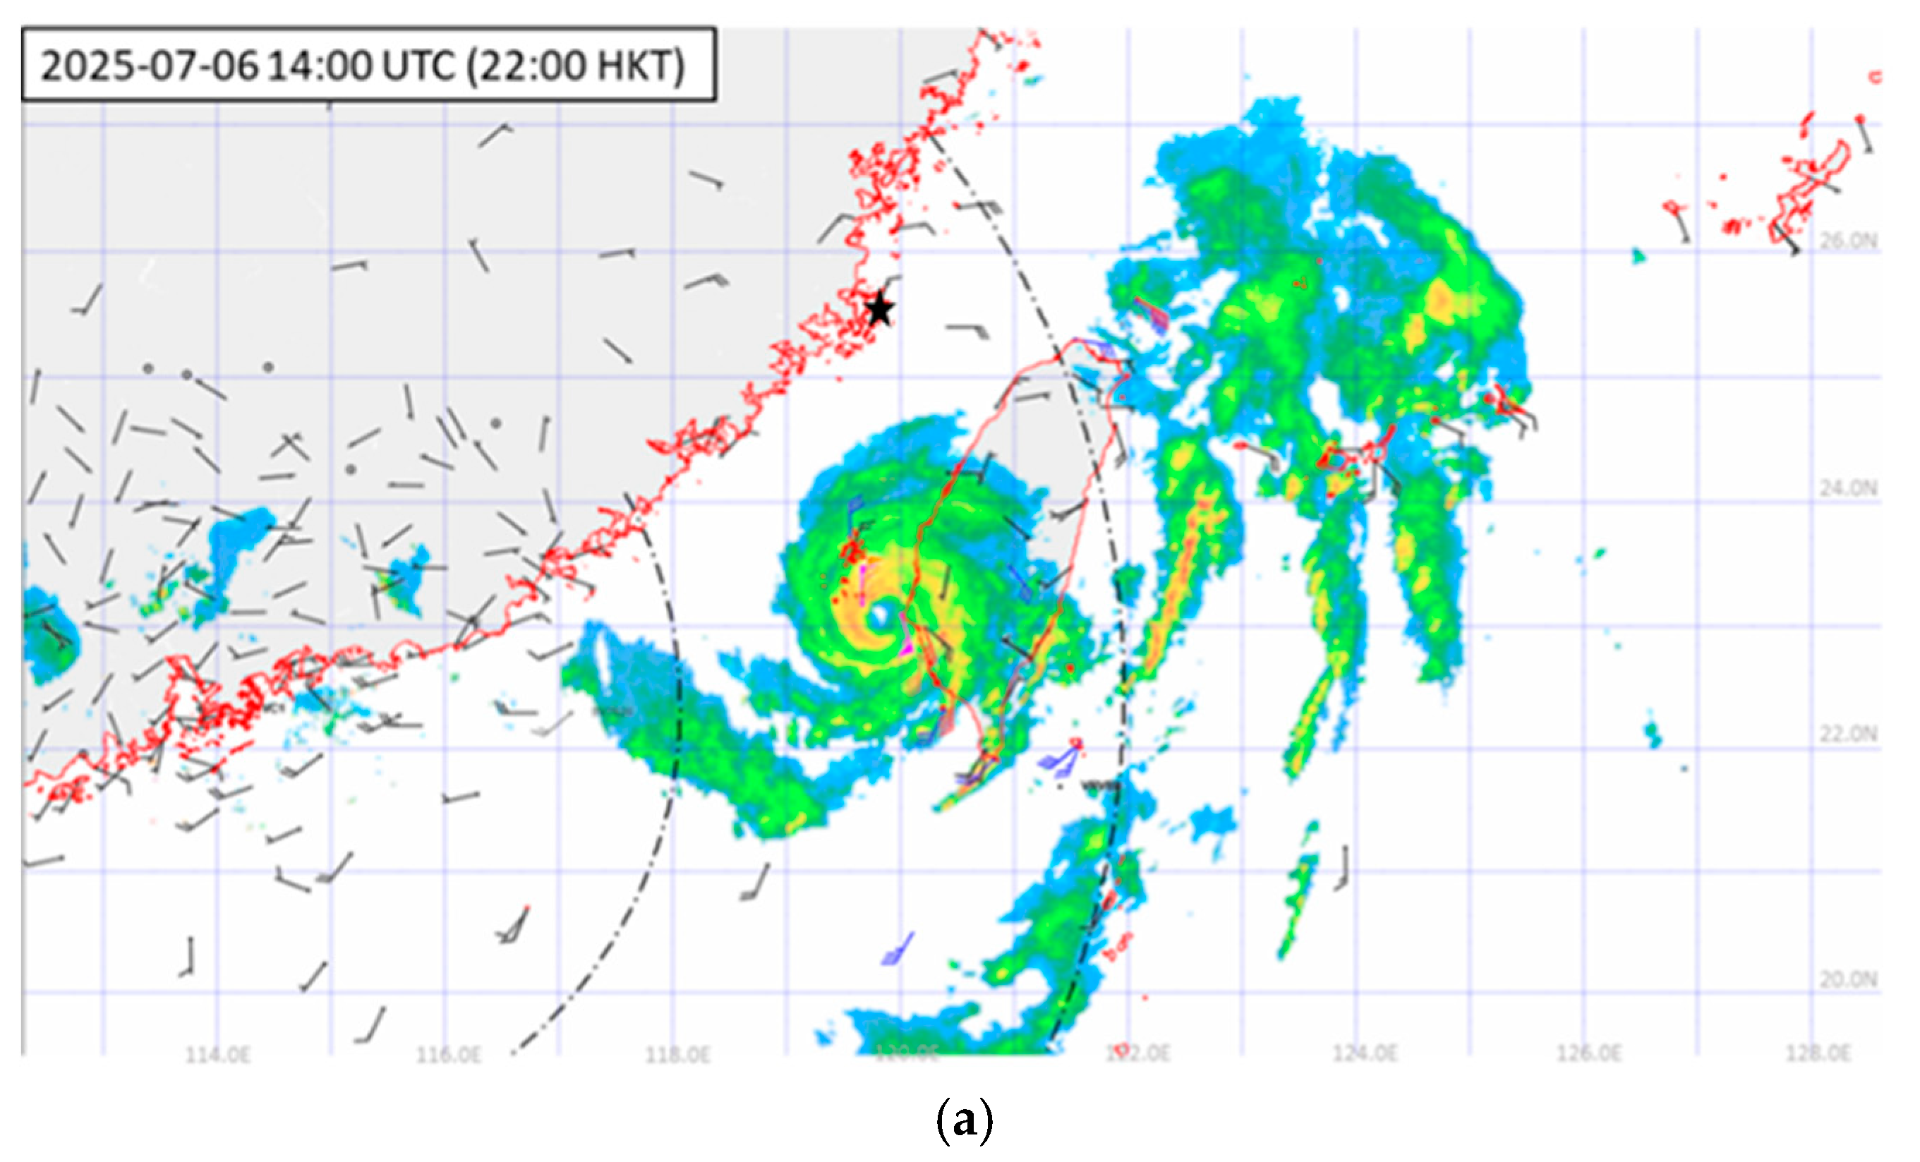

Hybrid Deep Learning and Quantum Network for Typhoon Forecasting in a Wind Power Farm
A hybrid quantum-classical deep learning system is utilized as our application for comprehensive typhoon forecasting and wind farm risk assessment. The system combines classical deep learning for multi-horizon, attention-based temporal modeling with quantum neural networks for quantum-enhanced sequential pattern recognition. Furthermore, the system simultaneously forecasts typhoon path, radius, intensity, wind speed, and the operational status of wind farm turbines during extreme weather events.

Slide 3
Project Overview
Hybrid deep learning + quantum network for typhoon forecasting
Goal. Improve typhoon and wind forecasting for wind power farms by fusing deep learning with quantum-enhanced neural networks.
Approach. Attention-based time-series models (Transformers, LSTMs) combined with quantum layers to capture nonlinear, high-dimensional spatiotemporal patterns.
NVIDIA role. GPU acceleration for deep learning training, with NVIDIA CUDA-Q used to simulate and integrate the quantum network layers.
Early signal. Preliminary tests on Western Pacific typhoon data show the hybrid model outperforming traditional techniques on wind speed, direction, and storm track.
Keywords. Typhoon Forecasting, Quantum AI, Wind Energy, Deep Learning, Climate Resilience.

Slide 4
Problem & Motivation
Typhoons are outpacing today’s forecasting tools
Rising risk. Increasing typhoon intensity across the Asia-Pacific threatens wind farms with wind fluctuations, structural damage, forced outages, and grid instability.
The gap. Physics-based NWP models (ECMWF, WRF) forecast large-scale atmospheric trends well, but struggle with the chaotic, nonlinear dynamics of typhoons and short-term wind variability.
The fix. A hybrid framework pairing the Temporal Fusion Transformer (TFT) with NVIDIA CUDA-Q quantum-enhanced layers, sharpening pattern recognition and multi-scale forecasting for extreme weather.
Why it matters. Better trajectory and wind predictions enable earlier operational decisions — curtailment, yaw/park, crew scheduling — protecting turbines and grid stability.

Slide 5
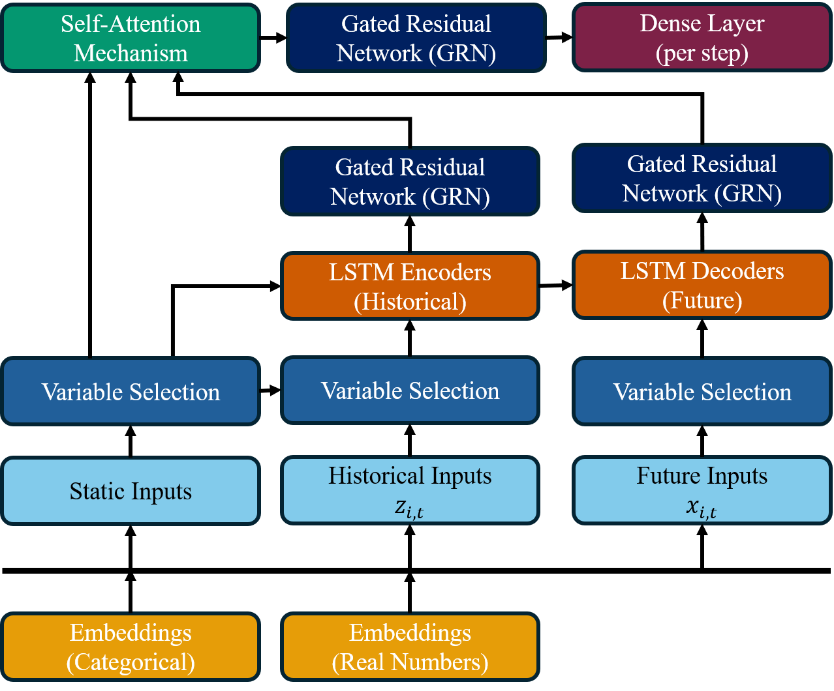
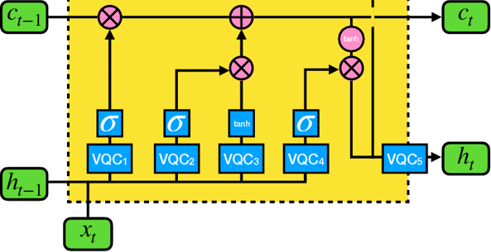
Scientific Driver
TFT handles multi-horizon temporal dependencies and exogenous selection (great for NWP post-processing).
QLSTM provides a compact, highly nonlinear temporal inductive bias that can boost tail prediction and calibration, kept in FP32 for numeric stability.
Temporal Fusion Transformer
Quantum LSTM

Slide 6
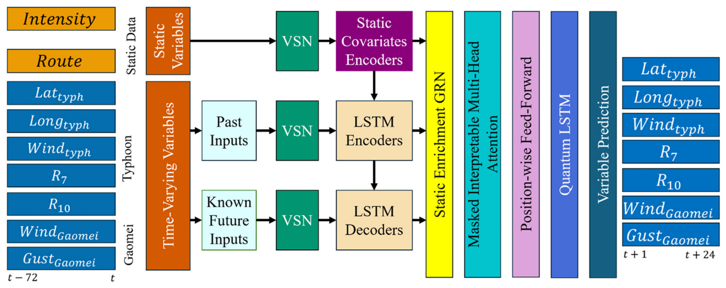
Basic Neural Architecture

Slide 7
Parameters to be used in the Architecture
Parameters | Value
Input/ Output Pairs (Hours) | 72/24
Static Covariates | Intensity, Route
Continuous Covariates | R7, R10
Gradient Clips | 0.5066
LSTM Layers | 1
Learning Rate | 0.06280
Hidden Layers | 110
Number of Attention Heads | 1
Dropout (%) | 22
VSN(%) | 20
Number of Qubits | 4
Number of Variational Layers | 1

Slide 8
Dataset
Multi-source meteorological data
Sources. ERA5, IBTrACS, Taiwan Central Weather Bureau records, and wind farm operating data spanning multiple years.
Format. Gridded time-series data (NetCDF), tabular meteorological records (CSV/TSV), and geospatial wind-potential maps.
Access. Entirely open-source under open-government or research licenses — no NDA or personal data involved.

Slide 9
GPU Hardware Specifications
Spec | RTX 3080 | A100 (80GB SXM) | RTX PRO 6000 Blackwell
FP32 (TFLOPS) | 29.8 | 19.5 | 126
BF16 Tensor, dense (TFLOPS) | 59.5 | 312 | ~500*
Memory | 10 GB GDDR6X | 80 GB HBM2e | 96 GB GDDR7
Memory Bandwidth | 760 GB/s | 2,039 GB/s | 1,792 GB/s
TDP | 320 W | 400 W | 600 W

Slide 10
Results
VARIABLE | MAE |  |  | RMSE |  |  | R2
 | RTX3080 | A100 | Blackwell 6000 | RTX3080 | A100 | Blackwell 6000 | RTX3080 | A100 | Blackwell 6000
Longitude | 1.9526e-4 | 1.9724e-4 | 1.9271e-4 | 3.2416e-4 | 3.7164e-4 | 3.3124e-4 | 0.9279 | 0.9836 | 0.9886
Latitude | 2.2198e-4 | 2.2749e-4 | 2.2764e-4 | 3.1986e-4 | 4.0799e-4 | 3.4645e-4 | 0.9304 | 0.9944 | 0.9984
Wind Speed | 2.0685e-3 | 2.061e-3 | 2.0360e-3 | 5.3174e-3 | 5.7867e-3 | 5.2520e-3 | 0.9097 | 0.9772 | 0.9782
7Dir | 2.4946e-3 | 2.4289e-3 | 2.5010e-3 | 0.01116 | 0.01437 | 0.01975 | 0.9166 | 0.9753 | 0.9763
10Dir | 2.2015e-5 | 8.1751e-4 | 2.9210e-4 | 0.01043 | 0.01398 | 0.01213 | 0.9332 | 0.9509 | 0.9539
Gaomei Wind Speed | 8.1471e-3 | 8.217e-3 | 6.0791e-3 | 0.01740 | 0.01890 | 0.01846 | 0.8375 | 0.9234 | 0.9334
Gaomei Wind Gust | 6.731e-3 | 6.577e-3 | 6.8681e-3 | 0.01442 | 0.01576 | 0.01682 | 0.8824 | 0.9340 | 0.9467
3.3 days
5+ hours
12 mins
RTX3080
(FP16 Precision-TF32, Epochs=50)
A100
(BF16-Mixed Precision, Epochs=50)
Blackwell Pro 6000
(BF16-Mixed Precision, Epochs=50)

Slide 11
Multi-core CPU vs GPU (training, 50 epochs)
Platform | Avg / epoch | 50-epoch total | Train it/s (≈) | Speedup vs CPU-16 cores
CPU (16 cores) | ~13.7 h | ~28.4 days | ~0.008 | 1.0×
CPU (32 cores) | ~9.1 h | ~19.0 days | ~0.012 | 1.5×
CPU (64 cores) | ~5.5 h | ~11.4 days | ~0.020 | 3.4×
RTX 3080 | 1h36m | 3.33 days | ~0.068 | 11.2×
A100 | 7m | 5h50m | ~0.936 | 77.8×
Blackwell 6000 | 15s | 12.5m | ~4.16 | 3288×

Slide 12
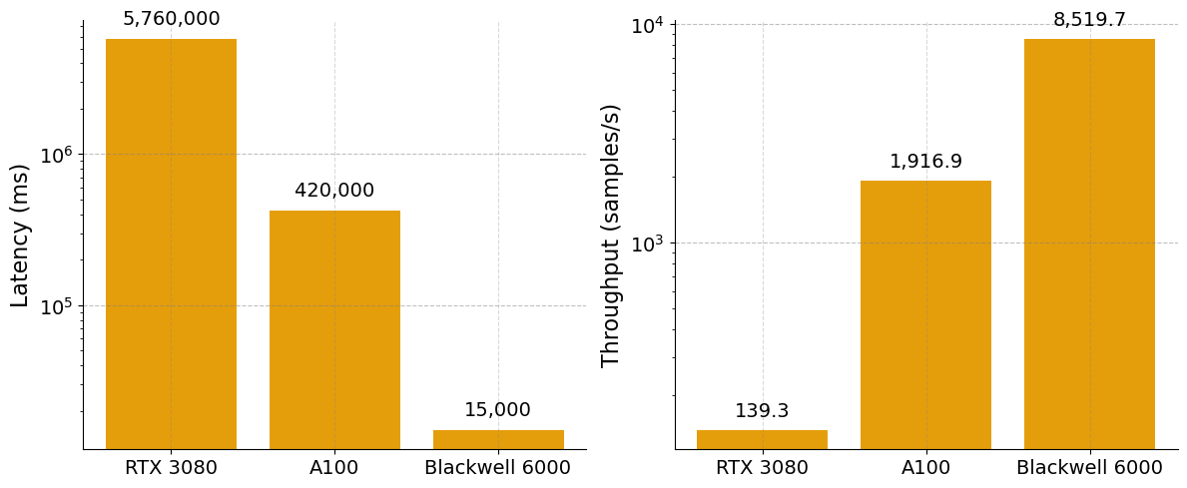
Latency and Throughput
61.2x
13.8x
0.07x
0.003x
Latency (Left): Processing time drops sharply from 5,760,000 ms (RTX 3080) to 15,000 ms (Blackwell 6000).
Throughput (Right): Processing speed surges from 139.3 samples/s (RTX 3080) up to 8,519.7 samples/s (Blackwell 6000).

Slide 13
Conclusion
High-Accuracy Forecasting: The hybrid Temporal Fusion Transformer (TFT) and Quantum LSTM framework successfully captures the chaotic, nonlinear dynamics of typhoons, achieving highly accurate predictions (R² > 0.94 on the Blackwell GPU) for trajectory, wind speed, and gusts.
Massive Performance Gains: Utilizing the NVIDIA Blackwell 6000 architecture dramatically reduces processing latency from 420,000ms to 15,000ms and boosts throughput to over 8,500 samples/s. This demonstrates a 288× speedup compared to standard 16-core CPUs.
Actionable Insights: By outperforming traditional physics-based NWP models in short-term wind variability, the hybrid system provides the early signals necessary for protecting wind turbines and ensuring grid stability.

Slide 14
Future Works
Scaling Qubit Capacity: The model's quantum state complexity is to be increased beyond the current 4-qubit architecture. The Quantum LSTM's representational capacity to process high-dimensional meteorological patterns will be exponentially enhanced by expanding the number of qubits.
Deepening Variational Layers: The quantum circuitry will be expanded beyond the single variational layer currently utilized. By leveraging the massive throughput of the Blackwell architecture, deeper, more complex quantum neural networks can be trained without sacrificing processing speed being sacrificed.
Maximizing Statistical Reliability: Specific improvements in Mean Absolute Error (MAE) and Root Mean Square Error (RMSE) for local wind variables are to be targeted. Pushing the R² values for Gaomei Wind Speed (currently 0.9334) and Wind Gust (currently 0.9467) closer to the near-perfect >0.99 reliability already achieved for latitude and longitude trajectory predictions is established as the primary goal.

Slide 15
References
[1] Y. Wang, Q. Yang, T. Li, and X. Hong, “Feasibility of typhoon models and wind power spectra on response analysis of parked wind turbines,” Journal of Wind Engineering and Industrial Aerodynamics, vol. 242, p. 105579, Nov. 2023, doi: https://doi.org/10.1016/j.jweia.2023.105579.
[2] L. Zhao et al., “State-of-the-art review on typhoon wind environments and their effects on long-span bridges,” Advances in Wind Engineering, vol. 1, no. 1, p. 100007, Sep. 2024, doi: https://doi.org/10.1016/j.awe.2024.100007.
[3] F. Mujjuni, T. R. Betts, and R. E. Blanchard, “Evaluation of Power Systems Resilience to Extreme Weather Events: A Review of Methods and Assumptions,” IEEE Access, vol. 11, pp. 87279–87296, Jan. 2023, doi: https://doi.org/10.1109/access.2023.3304643.
[4] X. Liu and J. Guo, “A Two-Step Approach for Forecasting Wind Speed at Offshore Wind Farms During Typhoons,” in Smart Grid Innov. Front. Telecommun. pp. 95–107, Jan. 2023, doi: https://doi.org/10.1007/978-3-031-31733-0_9.
[5] J. Li, Z. Song, X. Wang, Y. Wang, and Y. Jia, “A novel offshore wind farm typhoon wind speed prediction model based on PSO–Bi-LSTM improved by VMD,” Energy, vol. 251, p. 123848, Jul. 2022, doi: https://doi.org/10.1016/j.energy.2022.123848.
[6] G. Z. Yu, L. Lu, B. Tang, S. Y. Wang, and C. Y. Chung, “Ultra-Short-Term Wind Power Subsection Forecasting Method Based on Extreme Weather,” IEEE Trans. Power Syst., vol. 38, no. 6, pp. 5045–5056, Dec. 2022, doi: https://doi.org/10.1109/tpwrs.2022.3224557.
[7] H. Xu and W.-Y. Wang, “A Method Based on Numerical Wind Field and Extreme Learning Machine for Typhoon Wind Speed Prediction of Wind Farm,” Math. Prob. Eng., vol. 2021, pp. 1–15, Nov. 2021, doi: https://doi.org/10.1155/2021/7147973.
[8] S. Jiang, M. Liang, C. Wang, H. Fan, and Y. Ma, “Deep-TCP: Multi-source Data Fusion for Deep Learning-Powered Tropical Cyclone Intensity Prediction to Enhance Urban Sustainability,” Information Fusion, vol. 114, pp. 102670–102670, Sep. 2024, doi: https://doi.org/10.1016/j.inffus.2024.102670.
[9] P. Modé, C. Demartino, C. T. Georgakis, and N. D. Lagaros, “Short-term extreme wind speed forecasting using dual-output LSTM-based regression and classification model,” Journal of Wind Engineering and Industrial Aerodynamics, vol. 259, p. 106035, Apr. 2025, doi: https://doi.org/10.1016/j.jweia.2025.106035.
[10] B. Lim, S. Ö. Arık, N. Loeff, and T. Pfister, “Temporal Fusion Transformers for interpretable multi-horizon time series forecasting,” International Journal of Forecasting, vol. 37, no. 4, pp. 1748–1764, Oct. 2021, doi: https://doi.org/10.1016/j.ijforecast.2021.03.012.
[11] A. Ceschini, A. Rosato, and M. Panella, “Design of an LSTM Cell on a Quantum Hardware,” IEEE Transactions on Circuits & Systems II Express Briefs, vol. 69, no. 3, pp. 1822–1826, Nov. 2021, doi: https://doi.org/10.1109/tcsii.2021.3126204.
[12] S. Y. -C. Chen, S. Yoo and Y. -L. L. Fang, "Quantum Long Short-Term Memory," ICASSP 2022 - 2022 IEEE International Conference on Acoustics, Speech and Signal Processing (ICASSP), Singapore, Singapore, 2022, pp. 8622-8626, doi: 10.1109/ICASSP43922.2022.9747369.

Slide 16
Research supported by the NVIDIA Academic Grant Program using RTX PRO 6000 Blackwell Max-Q and CUDA Q

